Slide 1
Engas Test Trial – Independent verification by MANTRA
For Potato Head Beach Club
26-November-2018
PT Mantra Bali
Maitri Fischer
Chief Technical Officer
+62 81337030872
maitri@eco-mantra.com
Sean Nino Lotze
Head of Business Development
+62 821 44 197 137
nino@eco-mantra.com
Mendi Siahandan
Junior Consultant
+62 817 6420 553
mendi@eco-mantra.com

Slide 2
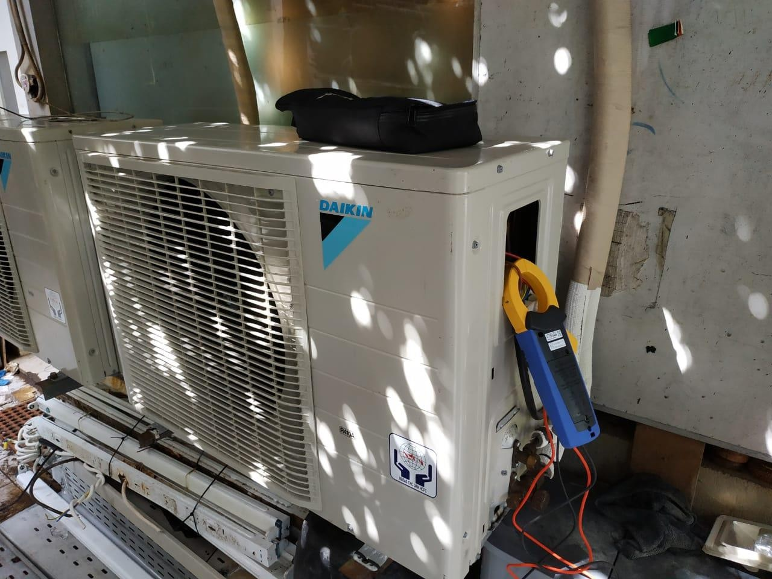
ENGAS Trial
PT Mantra Bali
1. Scope of Work
This report is an investigation into the energy savings of Engas M-60 Hydrocarbon as a retrofit for R410-a refrigerant. Two split, wall-mounted ACs in Engineering and Panel room at Potato Head Beach Club, Bali were used as a trial. A load study was carried out by Mantra on 14th November 2018 to verify the savings of Engas M-60 as well as the results of the solution provider, PT Eco Lifestyle.
Both ACs were chosen for the trial based on their condition, operation time (24-h) and location. The trial was conducted prior to retrofitting all 13 R-410a ACs in Potato Head Beach Club.
To accurately determine the load and electricity consumption of the compressor of the ACs, an energy logger was installed to log the electrical power demand. The duration of logging was 2 hours for each AC: 1 hour prior and 1 hour post the hydrocarbon refrigerant retrofitting.
The electrical current, voltage and power factor of the compressor was loged every 5 seconds using a HIOKI CM3286-01 Clamp On Power Tester with logging capabilities.
Figure 1. Power logging using HIOKI Clamp On Power Tester on a AC compressor at PHBC.
The ACs supply and return air temperature was also measured with a Dostman Log32THP temperature logger. This was carried out to investigate any effects the ENGAS hydrocarbon refrigerant might have on the AC functionality. The temperature logger recorded temperature and relative humidity data every 5 minutes.

Slide 3
ENGAS Trial
PT Mantra Bali
Table 1. ACs properties and logging periods
No | Rooms | Unit | Cap. (HP) | Before (R-410a) | After (Engas M-60)
1 | Engineering Room | 1 | 2 | 09:24 – 10:24 | 12:26 – 13:26
2 | Panel Room | 1 | 2 | 10:37 – 11:37 | 14:03 – 15:03
Findings
In effort to determine the performance comparison between before and after retrofit of the AC, there are 2 parameters that being used: the power demand (kW) and the supply-return air temperature difference (∆𝑇). The power demand profile of the AC will indicate the efficiency level of hydrocarbon retrofit savings. While ∆𝑇 is indicating the performance of the AC cooling capacity.
The proper retrofitting must result on reduction of power demand while maintaining the similar AC cooling capacity performance, which is represented by ∆𝑇 of the AC after retrofit has to remain relatively similar with the previous condition.
Engineering room AC
Figure 2 below shows the electrical power demand as well as the evaporator unit supply and
return temperature in the Engineering room during the logging period.
Logged Power Consumptions and Supply-Return Temperature of Engineering Room's AC
4 32.0
3.5 28.0
28.5
3 24.0
Power Demand (kW)
∆𝑇_{𝑖} =
2.5 10.8ºC
27.0
∆𝑇_{𝑓} = 11.1ºC
Air Temperature (C)
16.2
17.4
20.0
2
16.0
1.5
Refrigerant: R-410a
Refrigerant: Engas M-60
12.0
1
8.0
0.5
4.0
0
0:00
0:15 0:30
Power Demand Average Return Air Temp
0:45
1:00
Return Air Temp Average Supply
1:15
1:30 1:45
Supply Air Temp
0.0
2:00
Figure 2. Logged Power Consumptions and Supply-Return air temperature of Engineering Room’s AC

Slide 4
ENGAS Trial
PT Mantra Bali
It is evident that the average power demand of the AC compressor is reduced using ENGAS M- 60 hydrocarbon refrigerant from 1.57 kW to 1.07 kW.
This is equivalent to a reduced electrical power demand of 33.3%.
Further, the average temperature difference between return and supply air (∆𝑇) of the AC before and after M-60 retrofit did not change significantly. An average ∆𝑇 difference of 0.3 ºC before and after the retrofit is a 2.8% deviation from the initial condition and is not considered to have a noticeable significant impact on the system performance after reftrofitting. Moreover, this difference is expected to be caused by the increase in outdoor ambient air temperature as pre-retrofit data was obtained in the morning and post retrofit data in the afternoon when day temperatures are hottest.
2.2. Panel Room AC
Figure 2 below shows the electrical power demand as well as the evaporator unit supply and
return temperature in the Panel room during the logging period.
Logged Power Consumptions and Supply-Return Temperature of Panel Room AC
4 40.0
3.5 35.0
3
31.9
33.2
∆𝑇 =
30.0
Power Demand (kW)
2.5
∆𝑇_{𝑖} = 11.4ºC
𝑓
11.2ºC
25.0
Air Temperature (ºC)
20.5
22.0
2
20.0
1.5
Refrigerant: R-410a
Refrigerant: Engas M-60
15.0
1 10.0
0.5 5.0
0
0:00
0:15 0:30
Power Consumption (kW) Average Return Air Temp
0:45
1:00
Return Air Temp
1:15
1:30 1:45
Supply Air Temp
0.0
2:00
Average Supply Air Temp
Figure 3. Logged power consumptions and supply-return temperature of panel room ac
It is evident that the average power demand of the AC compressor is reduced using ENGAS M- 60 hydrocarbon refrigerant from 1.62 kW to 1.08 kW.
This is equivalent to a reduced electrical power demand of 33.3%.

Slide 5
ENGAS Trial
PT Mantra Bali
Further, the average temperature difference between return and supply air (∆𝑇) of the AC before and after M-60 retrofit did not change significantly. An average ∆𝑇 difference of 0.2 ºC before and after the retrofit is a 1.7% deviation from the initial condition and is not considered to have a noticeable significant impact on the system performance after reftrofitting. Moreover, this difference is expected to be caused by the increase in outdoor ambient air temperature as pre-retrofit data was obtained in the morning and post retrofit data in the afternoon when day temperatures are hottest.
3. Savings
Table 2 below summarizes the average daily energy consumption in kWh for the entire logging period. The power consumption of both ACs decreased by 33.3%.
The AC in engineering room is on for 24 hours per day, however we estimate that the compressor is only on for about 18h per day as the room is capable of reaching it’s set temperature and the compressor cycles on and off accordingly (see Figure 2). Under an 18h/day compressor run time, we calculate that the Engas M-60 hydrocarbon refrigerant decreases the daily electricity consumption from 28.26 kWh/day to 18.85 kWh/day.
Meanwhile, the AC in panel room, which runs for 24 hours per day, has a bigger daily electricity consumption reduction than the AC in the engineering room, decreasing from 38.92 kWh/day to
25.97 kWh/day for AC in panel room after the ENGAS hydrocarbon refrigerant.
4. Discussion and Conclusion
The hydrocarbon refrigerant retrofit trial was conducted for 2 ACs, in the Engineering room and Panel room. Both ACs were chosen for the trial based on their condition, operation time (24-h) and location. The trial was conducted prior to retrofitting all 10 R-410a ACs in Potato Head Beach Club.
From the trial result, Engas M-60 hydrocarbon retrofitting shows a potential of electricity savings of 33.3% while maintaining the same AC performance with the previous refrigerant. A slight difference of the average ∆𝑇 of 2-3% is attributed to different ambient air temperatures for the before and after data logging of the AC function.
The pre-retrofit log session is taken in the morning (9 am – 11 am) when temperature difference between indoor and outdoor was relative low. Meanwhile, the post retrofit log was taken during the peak daytime (12.30 pm – 3 pm), when the outdoor temperature and building heat gain is generally at its highest.

